Slide 1
EECS 150 - Components and Design Techniques for Digital Systems
Lec 20 – RTL Design Optimization
11/6/2007
Shauki Elassaad
Electrical Engineering and Computer Sciences
University of California, Berkeley
Slides adapted from Prof. Culler’s 2004 lecture
http://www-inst.eecs.berkeley.edu/~cs150

Slide 2
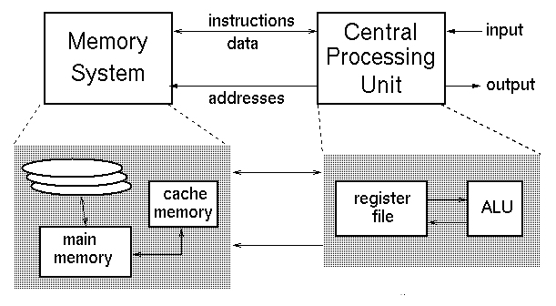
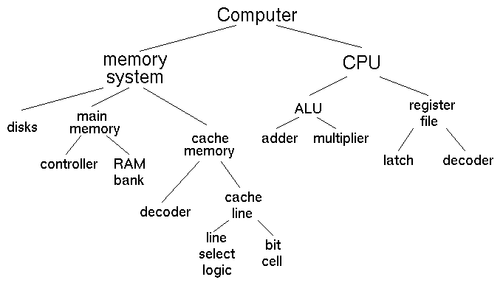
Levels of Design Representation
Pgm Language
Asm / Machine Lang
CS 61C
Instruction Set Arch
Machine Organization
HDL
FlipFlops
Gates
Circuits
EE 40
Devices
Transistor Physics
Transfer Function

Slide 3
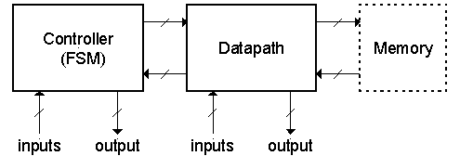
A Standard High-level Organization
Controller
  accepts external and control input, generates control and external output and sequences the movement of data in the datapath.
Datapath
  is responsible for data manipulation. Usually includes a limited amount of storage.
Memory
  optional block used for long term storage of data structures.
Standard model for CPUs, micro-controllers, many other digital sub-systems.
Usually not nested.
Often cascaded:

Slide 4
Datapath vs Control
Datapath
Controller
signals
Control Points
Datapath: Storage, FU, interconnect sufficient to perform the desired functions
  Inputs are Control Points
  Outputs are signals
Controller: State machine to orchestrate operation on the data path
  Based on desired function and signals

Slide 5
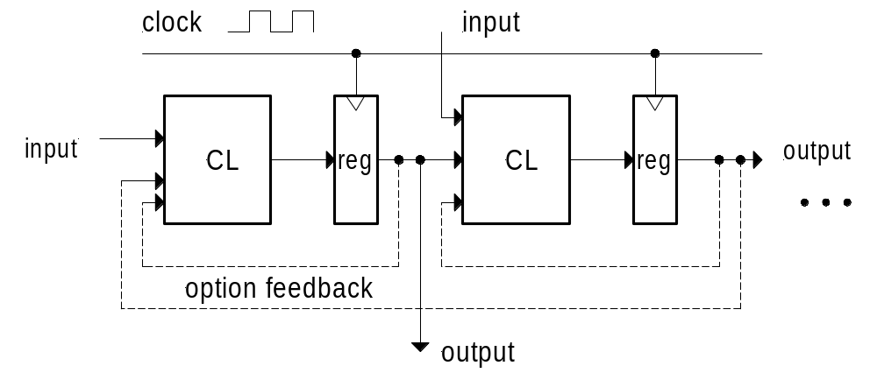
Register Transfer Level Descriptions
A standard high-level representation for describing systems.
It follows from the fact that all synchronous digital system can be described as a set of state elements connected by combination logic (CL) blocks:
RTL comprises a set of register transfers with optional operators as part of the transfer.
Example:
regA ← regB
regC ← regA + regB
if (start==1) regA ← regC
Personal style:
  use “;” to separate transfers that occur on separate cycles.
  Use “,” to separate transfers that occur on the same cycle.
Example (2 cycles):
regA ← regB, regB ← 0;
regC ← regA;

Slide 6
RTL Abstraction
Increases productivity by allowing designers to focus on behavior rather than gate-level logic
  Design components can be specified w/ concise and modular code in verilog
  Synthesis tools understand RTL design
Think of design in terms of Control and Datapath.
Designers are still very close to hardware. They can think of and optimize architectures, timing (cycle-level), and other design trade-offs (power, speed, area..)

Slide 7
RTL Design Process
Data-path Requirements
  How many registers do you need?
  What transformations/operations are needed?
Interface Requirements
  What signals control the operations?
  What order these signals are in?
State-machine design
  What are the outputs in each state?
  Look for concurrency in the design.

Slide 8
A Register Transfer
A
B
C ← A
Sel ← 0; Ld ← 1
C ← B
Sel ← 1; Ld ← 1
D
E
C
Sel₀
Sel
0
1
Sel₁
Bus
Ld
C
Clk
Sel
Ld
Clk
A on Bus
B on Bus
One of potentially many source regs goes on the bus to one or more destination regs
Register transfer on the clock
Ld C
from Bus
?

Slide 9
Register Transfers - interconnect
Point-to-point connection
  Dedicated wires
  Muxes on inputs of
  each register
Common input from multiplexer
  Load enables
  for each register
  Control signals
  for multiplexer
Common bus with output enables
  Output enables and load
  enables for each register
MUX
MUX
MUX
MUX
rs
rt
rd
R4
rs
rt
rd
R4
MUX
rs
rt
rd
R4
BUS

Slide 10
Register Transfer – multiple busses
One transfer per bus
Each set of wires can carry one value
State Elements
  Registers
  Register files
  Memory
Combinational Elements
  Busses
  ALUs
  Memory (read)
MUX
MUX
MUX
MUX
rs
rt
rd
R4

Slide 11
Registers
Selectively loaded – EN or LD input
Output enable – OE input
Multiple registers – group 4 or 8 in parallel
LD
D7
D6
D5
D4
D3
D2
D1
D0
OE
Q7
Q6
Q5
Q4
Q3
Q2
Q1
Q0
OE asserted causes FF state to be
connected to output pins; otherwise they
are left unconnected (high impedance)
LD asserted during a lo-to-hi clock
transition loads new data into FFs
CLK

Slide 12
Register Files
Collections of registers in one package
  Two-dimensional array of FFs
  Address used as index to a particular word
  Separate read and write addresses so can do both at same time
Ex: 4 by 4 register file
  16 D-FFs
  Organized as four words of four bits each
  Write-enable (load)
  Read-enable (output enable)
RE
RB
RA
WE
WB
WA
D3
D2
D1
D0
Q3
Q2
Q1
Q0

Slide 13
Memories
Larger Collections of Storage Elements
  Implemented not as FFs but as much more efficient latches
  High-density memories use 1-5 switches (transitors) per bit
Ex: Static RAM – 1024 words each 4 bits wide
  Once written, memory holds forever (not true for denser dynamic RAM)
  Address lines to select word (10 lines for 1024 words)
  Read enable
    Same as output enable
    Often called chip select
    Permits connection of many
    chips into larger array
  Write enable (same as load enable)
  Bi-directional data lines
    output when reading, input when writing
RD
WR
A9
A8
A7
A6
A5
A4
A3
A2
A2
A1
A0
IO3
IO2
IO1
IO0

Slide 14
ALU
Block Diagram
  Input: data and operation to perform
    Add, Sub, AND, OR, NOT, XOR, …
  Output: result of operation and status information
A
B
16
16
Operation
16
N
S
Z

Slide 15




Data Path (Hierarchy)
Arithmetic circuits constructed in hierarchical and iterative fashion
  each bit in datapath is
  functionally identical
  4-bit, 8-bit, 16-bit,
  32-bit datapaths
Cin
Ain
FA
Sum
Bin
Cout
Ain
Sum
HA
Bin
Cout
HA
Cin

Slide 16
Example Data Path (ALU + Registers)
Accumulator
  Special register
  One of the inputs to ALU
  Output of ALU stored back in accumulator
One-input Operation
  Other operand and destination
  is accumulator register
  AC <– AC op REG
  ”Single address instructions”
    AC <– AC op Mem[addr]
16
REG
AC
16
16
OP
N
16
Z

Slide 17
Data Path (Bit-slice)
Bit-slice concept: iterate to build n-bit wide datapaths
Data bit busses run through the slice
CO
ALU
CI
CO
ALU
ALU
CI
AC
AC
AC
R0
R0
R0
rs
rs
rs
rt
rt
rt
rd
rd
rd
from
memory
from
memory
from
memory
1 bit wide
2 bits wide

Slide 18
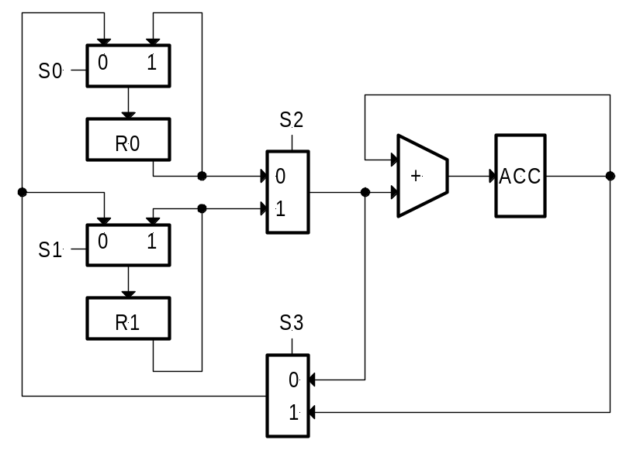
Example of Using RTL
RTL description is used to sequence the operations on the datapath (dp).
It becomes the high-level specification for the controller.
Design of the FSM controller follows directly from the RTL sequence. FSM controls movement of data by controlling the multiplexor/tri-state control signals.
ACC ← ACC + R0, R1 ← R0;
ACC ← ACC + R1, R0 ← R1;
R0 ← ACC;
•
•
•

Slide 19
Example of Using RTL
RTL often used as a starting point for designing both the dp and the control:
example:
regA ← IN;
regB ← IN;
regC ← regA + regB;
regB ← regC;
From this we can deduce:
  IN must fanout to both regA and regB
  regA and regB must output to an adder
  the adder must output to regC
  regB must take its input from a mux that selects between IN and regC
What does the datapath look like:
The controller:

Slide 20
Announcements
Lab Etiquette
  Food in the lab is still a problem. If problem persists, we will be forced to close the lab when TAs are not present!
Discussion sessions are on for this week.
No Lab Lecture this week

Slide 21
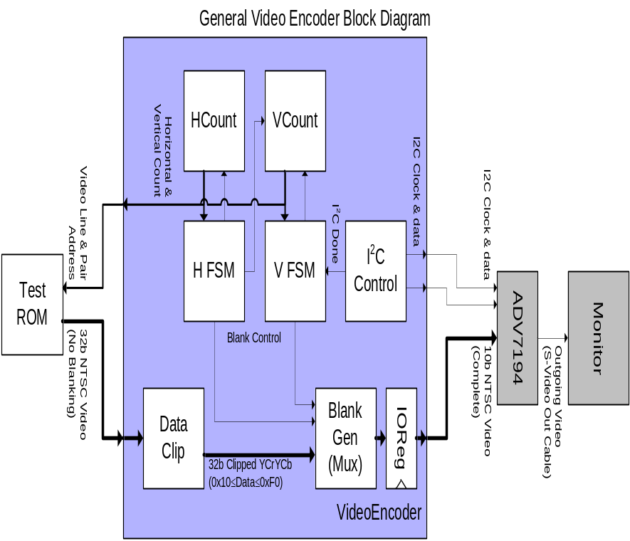
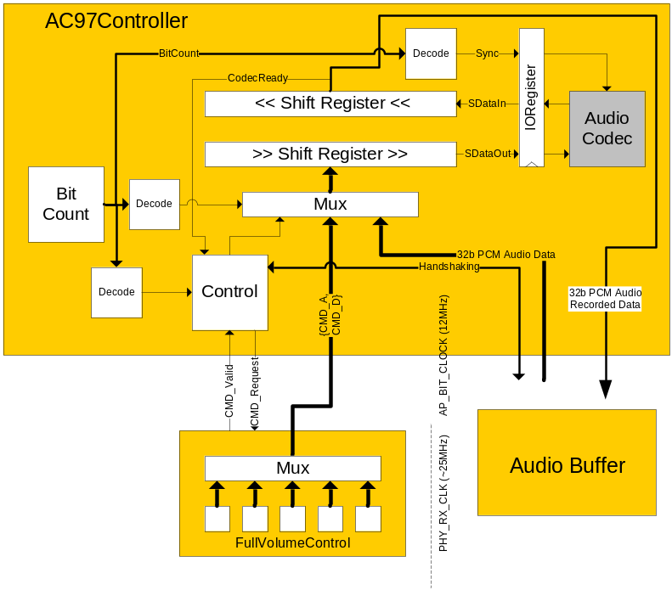
How does RTL design relate to your project?
Understanding data-flow at this level simplifies and clarifies the design
  Data going in and out of Audio Buffer is specified at packet level (not at bit-level).
  Compare this block diagram to the detailed synthesized gate-level design
Micro-architecture is influenced by design library:

Slide 22
Components of the data path
Storage
  Flip-flops
  Registers
  Register Files
  SRAM
Arithmetic Units
  Adders, subtraters, ALUs (built out of FAs or gates)
  Comparators
  Counters
Interconnect
  Wires
  Busses
  Tri-state Buffers
  MUX

Slide 23
Arithmetic Circuit Design
Full Adder
Adder
Relationship of positional notation and operations on it to arithmetic circuits
Each componet has associated costs:
  Power
  Speed
  Area
  Reliability
A B Cin
FA
Co S

Slide 24
List Processor Example
RTL gives us a framework for making high-level optimizations.
  Fixed function unit
  Approach extends to instruction interpreters
General design procedure outline:
  1. Problem, Constraints, and Component Library Spec.
  2. “Algorithm” Selection
  3. Micro-architecture Specification
  4. Analysis of Cost, Performance, Power
  5. Optimizations, Variations
  6. Detailed Design

Slide 25
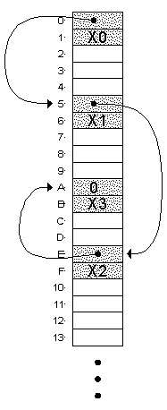
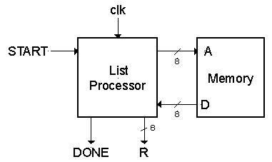
1. Problem Specification
Design a circuit that forms the sum of all the 2's complements integers stored in a linked-list structure starting at memory address 0:
All integers and pointers are 8-bit. The link-list is stored in a memory block with an 8-bit address port and 8-bit data port, as shown below. The pointer from the last element in the list is 0. At least one node in list.
I/Os:
  START resets to head of list and starts addition process.
  DONE signals completion
  R, Bus that holds the final result

Slide 26
1. Other Specifications
Design Constraints:
  Usually the design specification puts a restriction on cost, performance, power or all. We will leave this unspecified for now and return to it later.
Component Library:
component delay
simple logic gates 0.5ns
n-bit register clk-to-Q=0.5ns
setup=0.5ns (data and LD)
n-bit 2-1 multiplexor 1ns
n-bit adder (2 log(n) + 2)ns
memory 10ns read (asynchronous read)
zero compare 0.5 log(n)
  (single ported memory)
  Are these reasonable?

Slide 27
2. Algorithm Specification
In this case the memory only allows one access per cycle, so the algorithm is limited to sequential execution. If in another case more input data is available at once, then a more parallel solution may be possible.
Assume datapath state registers NEXT and SUM.
  NEXT holds a pointer to the node in memory.
  SUM holds the result of adding the node values to this point.
If (START==1) NEXT←0, SUM←0;
repeat {
SUM←SUM + Memory[NEXT+1];
NEXT←Memory[NEXT];
} until (NEXT==0);
R←SUM, DONE←1;

Slide 28
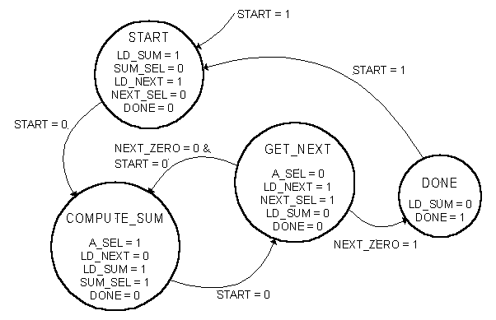
3. Architecture #1
Direct implementation of RTL description:
Datapath
D
0
+
NEXT_SEL
1
0
A_SEL
Memory
0
0
A
SUM_SEL
1
0
LD_NEXT
NEXT
1
1
LD_SUM
SUM
+
Controller
==0
NEXT_ZERO
If (START==1) NEXT←0, SUM←0;
repeat {
SUM←SUM + Memory[NEXT+1];
NEXT←Memory[NEXT];
} until (NEXT==0);
R←SUM, DONE←1;

Slide 29
4. Analysis of Cost, Performance, and Power
Skip Power for now.
Cost:
  How do we measure it? # of transistors? # of gates? # of CLBs?
  Depends on implementation technology. Usually we are interested in comparing the relative cost of two competing implementations. (Save this for later)
Performance:
  2 clock cycles per number added.
  What is the minimum clock period?
  The controller might be on the critical path. Therefore we need to know the implementation, and controller input and output delay.

Slide 30
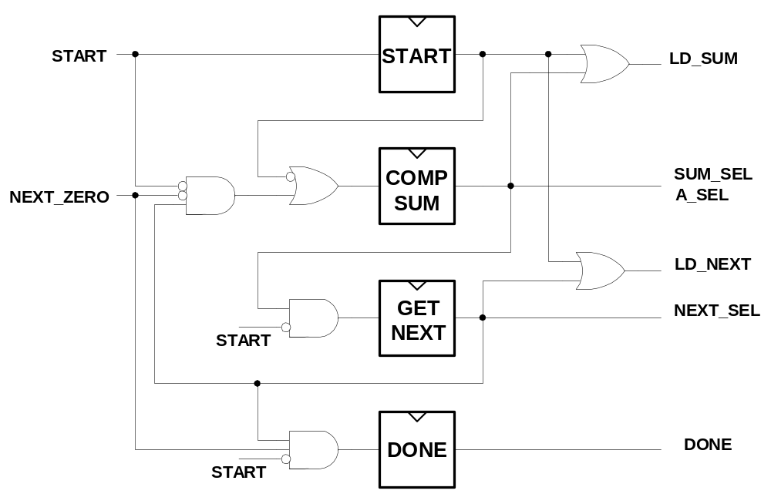
Possible Controller Implementation
Based on this, what is the controller input and output delay?

Slide 31
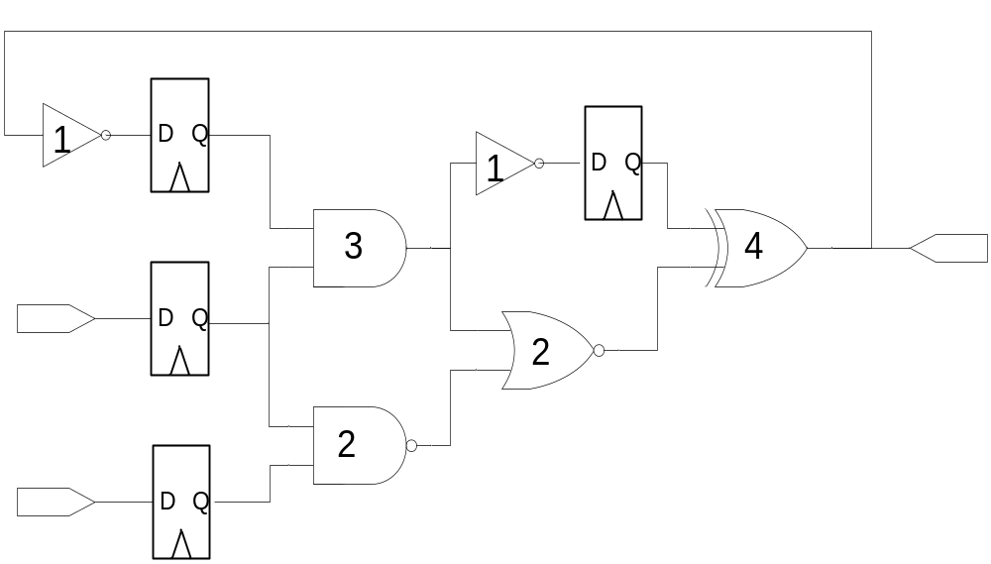
Critical Path…
Longest path from any reg out to any reg input

Slide 32
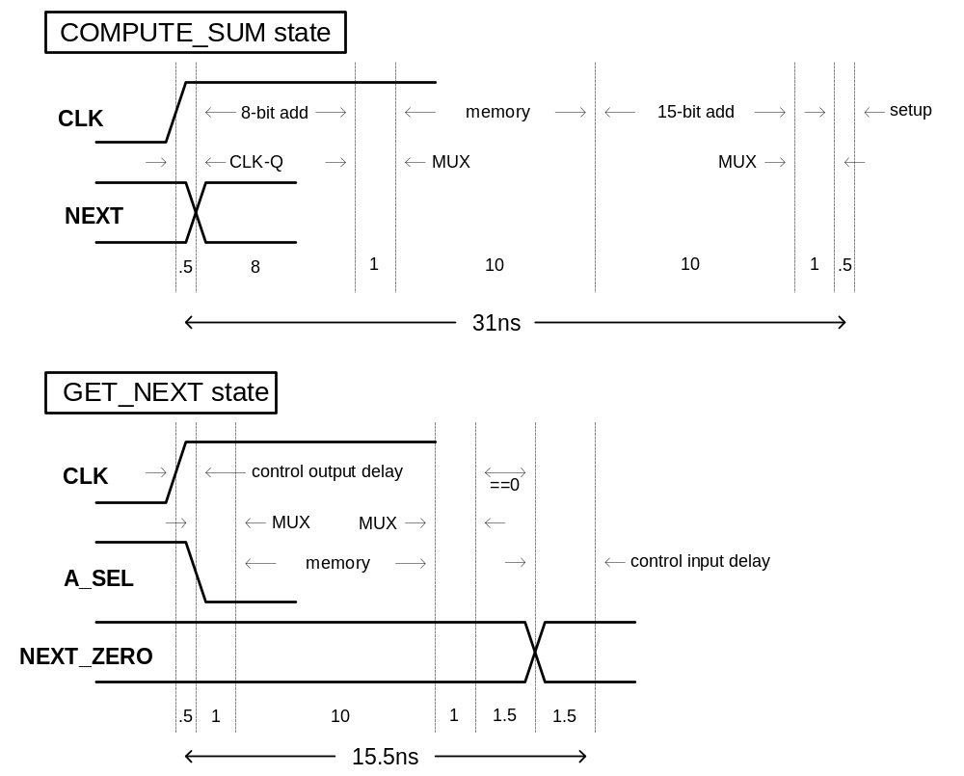
4. Analysis of Performance

Slide 33
Critical paths
D
0
+
NEXT_SEL
1
0
A_SEL
Memory
0
0
A
SUM_SEL
1
0
LD_NEXT
NEXT
1
1
LD_SUM
SUM
+
==0
NEXT_ZERO
Identify bottlenecks in design
Share/schedule resources to improve performance

Slide 34
4. Analysis of Performance
Detailed timing:
  clock period (T) = max (clock period for each state)
  T > 31ns, F < 32 MHz
Observation:
  COMPUTE_SUM state does most of the work. Most of the components are inactive in GET_NEXT state.
  GET_NEXT does: Memory access + …
  COMPUTE_SUM does: 8-bit add, memory access, 15-bit add + …
Conclusion:
  Move one of the adds to GET_NEXT.

Slide 35
5. Optimization
Add new register named NUMA, for address of number to add.
Update RTL to reflect our change (note still 2 cycles per iteration):
If (START==1) NEXT←0, SUM←0, NUMA←1;
repeat {
SUM←SUM + Memory[NUMA];
NUMA←Memory[NEXT] + 1,
NEXT←Memory[NEXT] ;
} until (NEXT==0);
R←SUM, DONE←1;

Slide 36
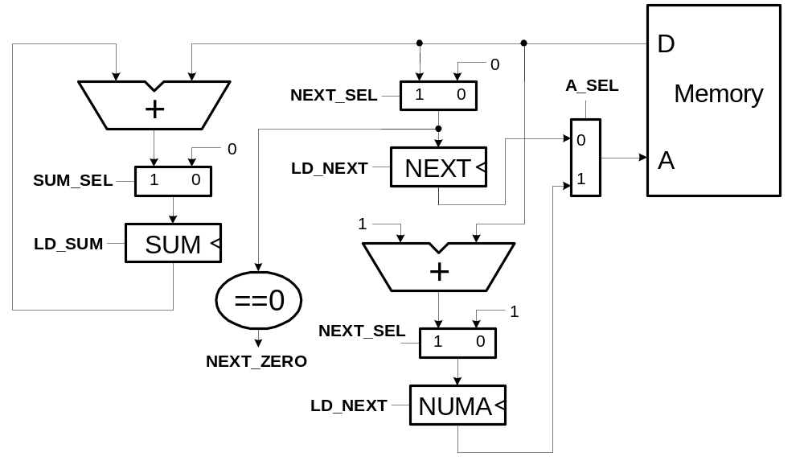
5. Optimization
Architecture #2:
Incremental cost: addition of another register and mux.
If (START==1) NEXT←0, SUM←0, NUMA←1;
repeat {
SUM←SUM + Memory[NUMA];
NUMA←Memory[NEXT] + 1, NEXT←Memory[NEXT] ;
} until (NEXT==0);
R←SUM, DONE←1;

Slide 37
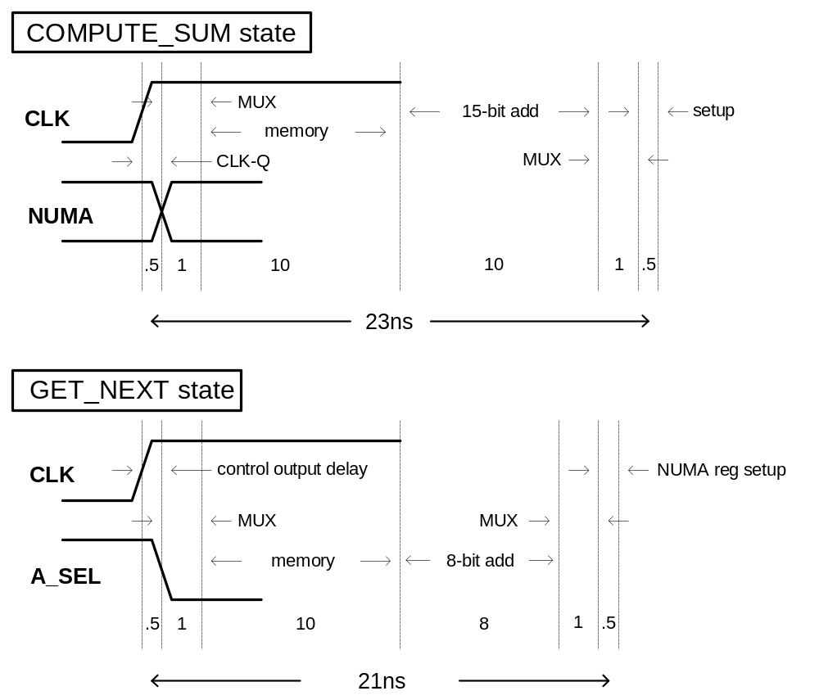
5. Optimization, Architecture #2
New timing:
Clock Period (T) = max (clock period for each state)
T > 23ns, F < 43Mhz
Is this worth the extra cost?
Can we lower the cost?
Notice that the circuit now only performs one add on every cycle. Why not share the adder for both cycles?

Slide 38
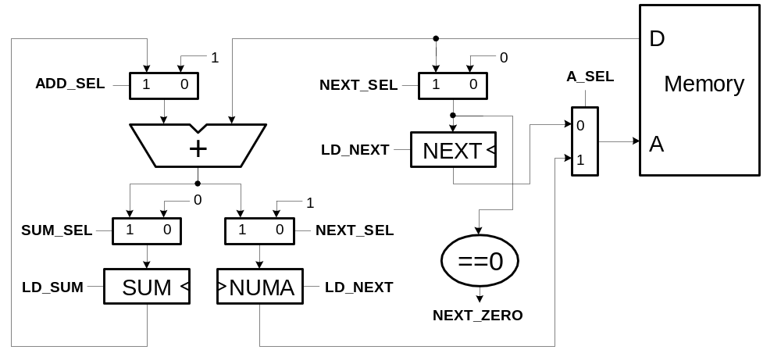
5. Optimization, Architecture #3
Incremental cost:
  Addition of another mux and control. Removal of an 8-bit adder.
Performance:
  mux adds 1ns to cycle time. 24ns, 41.67MHz.
Is the cost savings worth the performance degradation?

Slide 39
Design Complexity & Productivity Gap
Design gap is accelerating with advances in processing technology.
RTL Designers must identify downstream problems — timing, signal integrity, reliability, and others — prior to synthesis and be able to implement design fixes where they will have a more significant impact on chip performance.
The key to a successful design is design closure. The various performance specifications comprising timing, power, and reliability, along with chip cost, are all closely coupled.
EETimes 08/22/2003

Slide 40
Design Gap
Keeping up with Moore's Law requires the implementation of disruptive design technology every few years.
A common theme of advancing design technology is the continuing move to higher design abstraction levels.

